Slide 1
Understanding Images and Classification with Linear Classifiers
Course Code: CSC 4254
Course Title: Computer Vision & Pattern Recognition
Dept. of Computer Science
Faculty of Science and Technology
Lecturer No: | 2 | Week No: | 1 | Semester:
Lecturer:

Slide 2
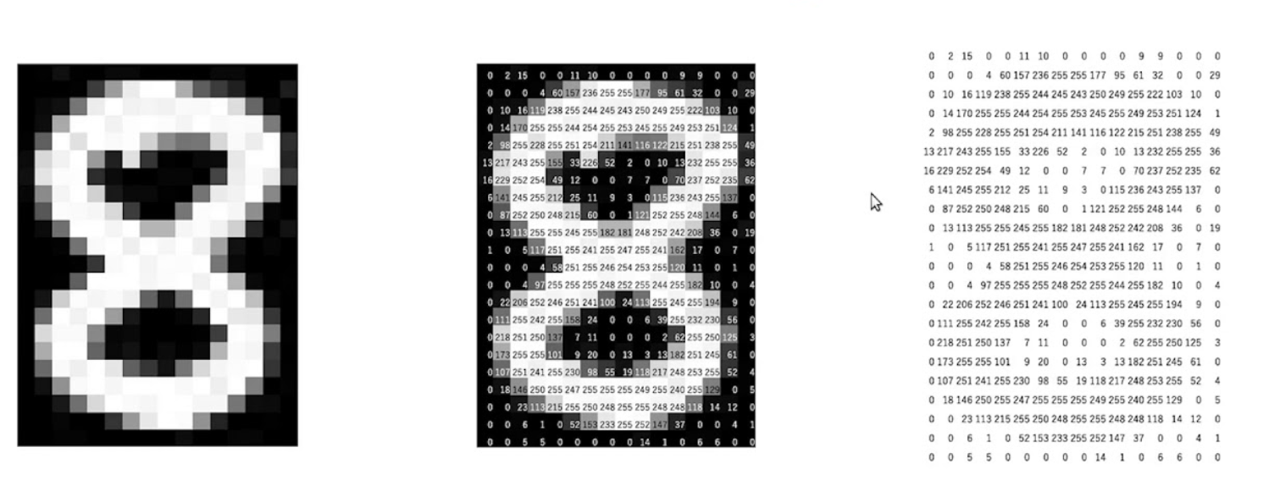
Understanding an Image
Gray Scale Image
Black(0) and White(255) Anything in between is shades of gray

Slide 3
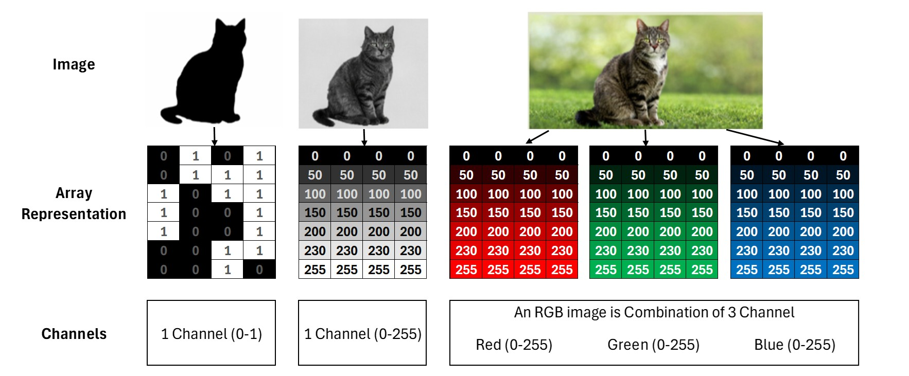
Understanding an Image
Binary Image
Gray Scale Image (Black and White)
RGB Image

Slide 4
What can we do with Images?
Image Classification A Core Task in computer vision
The image classification task
Two basic data-driven approaches to image classification
K-nearest neighbor
Linear classifier
Lecture 2 -
4

Slide 5
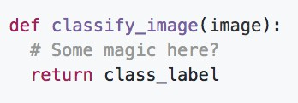
An image classifier
Unlike e.g. sorting a list of numbers, no obvious way to hard-code the algorithm for recognizing a cat, or other classes.
Lecture 2 -
5

Slide 6
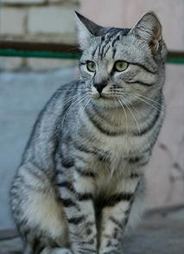
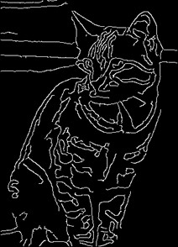
Attempts have been made
Find edges
Find corners
?
John Canny, “A Computational Approach to Edge Detection”, IEEE TPAMI 1986
Lecture 2 -
6

Slide 7
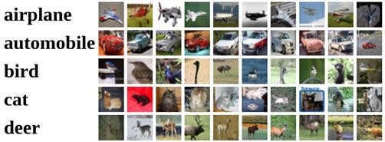
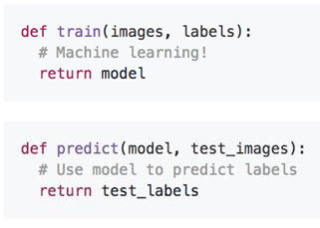
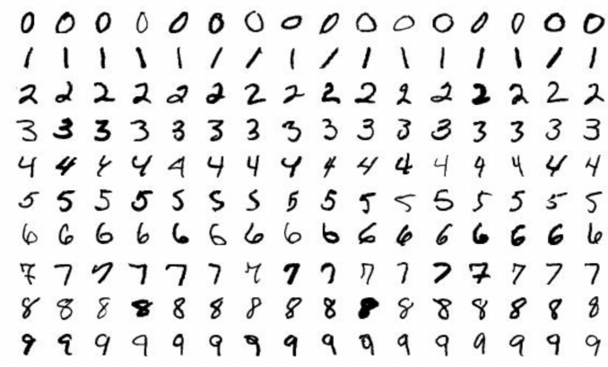
Machine Learning: Data-Driven Approach
Collect a dataset of images and labels
Use Machine Learning algorithms to train a classifier
Evaluate the classifier on new images
CIFAR10 Dataset
MNIST Dataset
Lecture 2 -
7

Slide 8
Nearest Neighbor Classifier
Lecture 2 -
8

Slide 9
First classifier: Nearest Neighbor
def train(images, labels):
# Machine Learning
Memorize all data and labels
Predict the label of the most similar training image
def predict(test_images):
# use model to predict labels
return predicted_labels
Lecture 2 -
9

Slide 10
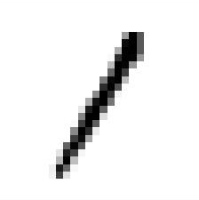
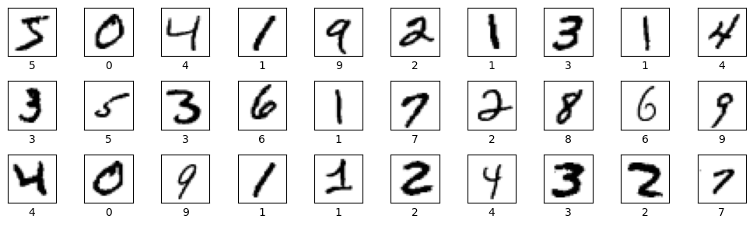
First classifier: Nearest Neighbor
query data
Training data with labels
|
|
-
=
R (Real Number)
Lecture 2 -
10

Slide 11

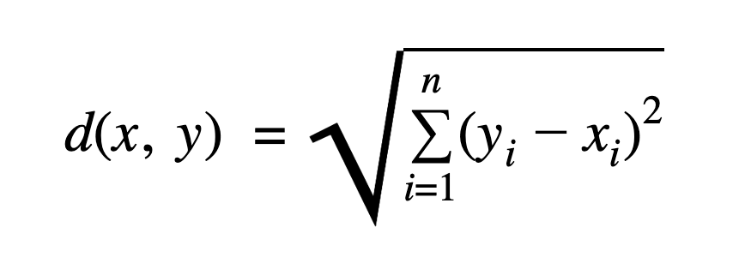
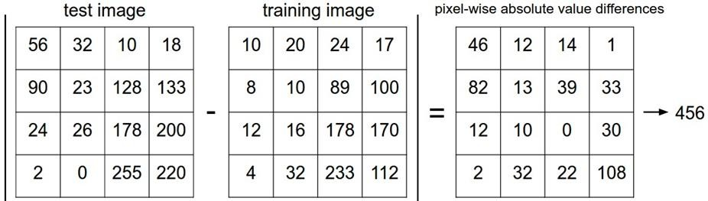
Distance Metric to compare images
L1 distance (Manhattan):
or
L2 distance (Euclidian):
e.g. Using L1 to compare distance:
add
11

Slide 12

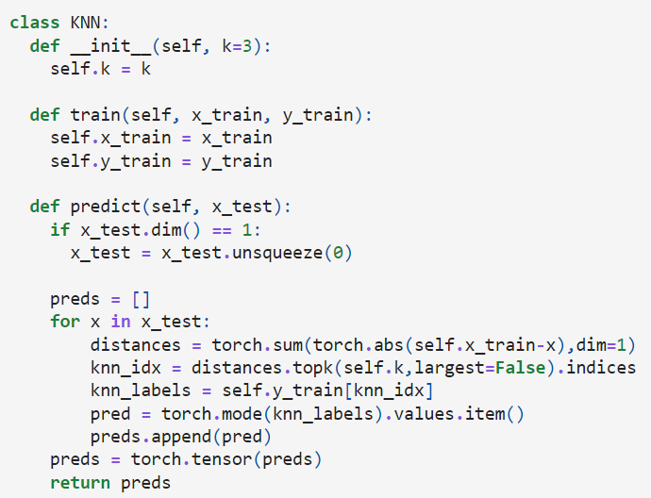
K-Nearest Neighbors (KNN)
For each test sample, the Manhattan distance to all training samples is computed.
The k nearest neighbors (smallest distances) are selected.
The predicted label is determined using a majority vote among the neighbors’ labels.
Lecture 2 -
12

Slide 13
K-Nearest Neighbors (KNN)
Memorize training data
Lecture 2 -
13

Slide 14
K-Nearest Neighbors (KNN)
For each test image:
Find closest train image
Predict label of nearest image
Lecture 2 -
14

Slide 15

K-Nearest Neighbors (KNN)
Question: With N examples, how fast are training and prediction?
Train: O(1)
Predict: O(k * n * d)
n: Number of training data points.
d: Data dimensionality (number of features).
k: Number of neighbors to consider.
This is bad: we want classifiers that are fast at prediction; slow for training is ok
Lecture 2 -

Slide 16
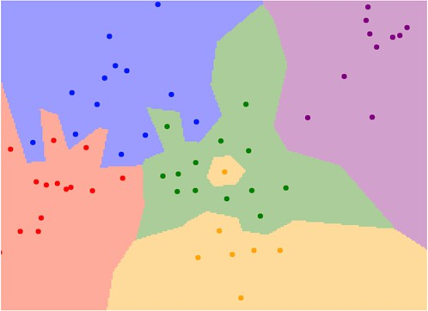
What does this look like?
1-nearest neighbor
Lecture 2 -

Slide 17

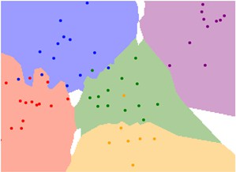
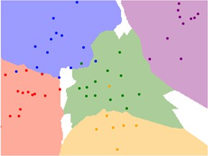
K-Nearest Neighbors
Instead of copying label from nearest neighbor,
take majority vote from K closest points
K = 1
K = 3
K = 5
Lecture 2 -

Slide 18

K-Nearest Neighbors: Distance Metric
L1 (Manhattan) distance L2 (Euclidean) distance
Lecture 2 -

Slide 19
K-Nearest Neighbors: Distance Metric - Example
L1 Distance: Measures distance by moving along grid lines (like walking in a city with square blocks).
L2 Distance: Measures the straight-line distance (as the crow flies).
B(0.5, 0.5)
B(1/√2, 1/√2)
O(0,0)
A(1, 0)
O(0,0)
A(1, 0)
d₁(O,A) = |0-1| + |0-0| = 1
d₁(O,B) = |0-0.5| + |0-0.5| = 0.5 + 0.5 = 1
d₁(O,A) = d₁(O,B) = 1
d₂(O,A) = sqrt((0-1)² + (0-0)²) = sqrt(1²) = 1
d₂(O,B) = sqrt((0-1/√2)² + (0-1/√2)²) = sqrt(1/2+1/2) = sqrt(1) = 1
d₂(O,A) = d₂(O,A) = 1
Lecture 2 -33

Slide 20
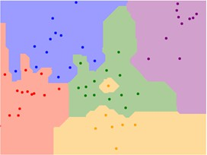
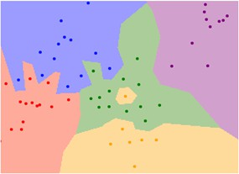
K-Nearest Neighbors: Distance Metric
L1 (Manhattan) distance L2 (Euclidean) distance
K = 1
K = 1
Lecture 2 -

Slide 21
Hyperparameters
What is the best value of k to use? What is the best distance to use?
These are hyperparameters: choices about the algorithms themselves.
Very problem/dataset-dependent.
Must try them all out and see what works best.
Lecture 2 -

Slide 22
Setting Hyperparameters
Idea #1: Choose hyperparameters that
work best on the training data
train
Lecture 2 -

Slide 23
Setting Hyperparameters
Idea #1: Choose hyperparameters that
work best on the training data
BAD: K = 1 always works perfectly on training data
train
Lecture 2 -

Slide 24
Setting Hyperparameters
Idea #1: Choose hyperparameters that
work best on the training data
BAD: K = 1 always works perfectly on training data
train
Idea #2: choose hyperparameters
that work best on test data
train
test
Lecture 2 -

Slide 25
Setting Hyperparameters
Idea #1: Choose hyperparameters that
work best on the training data
BAD: K = 1 always works perfectly on training data
train
Idea #2: choose hyperparameters
that work best on test data
BAD: No idea how algorithm
will perform on new data
train
test
Never do this!
Lecture 2 -

Slide 26
Setting Hyperparameters
Idea #1: Choose hyperparameters that
work best on the training data
BAD: K = 1 always works perfectly on training data
train
Idea #2: choose hyperparameters
that work best on test data
BAD: No idea how algorithm
will perform on new data
train
test
Idea #3: Split data into train, val; choose
hyperparameters on val and evaluate on test
Better!
train | validation | test
Lecture 2 -

Slide 27
Setting Hyperparameters
train
Idea #4: Cross-Validation: Split data into folds, try
each fold as validation and average the results
fold 1 | fold 2 | fold 3 | fold 4 | fold 5
fold 1 | fold 2 | fold 3 | fold 4 | fold 5
fold 1 | fold 2 | fold 3 | fold 4 | fold 5
fold 1 | fold 2 | fold 3 | fold 4 | fold 5
fold 1 | fold 2 | fold 3 | fold 4 | fold 5
test
Useful for small datasets, but not used too frequently in deep learning
Lecture 2 -

Slide 28
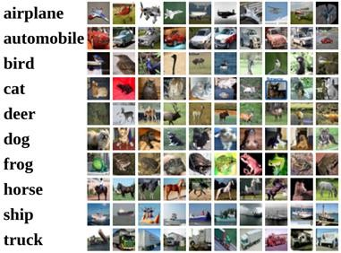
Example Dataset: CIFAR10
10 classes
50,000 training images
10,000 testing images
Alex Krizhevsky, “Learning Multiple Layers of Features from Tiny Images”, Technical Report, 2009.
Lecture 2 -

Slide 29
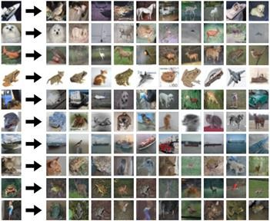
Example Dataset: CIFAR10
10 classes
50,000 training images
10,000 testing images
Test images and nearest neighbors
Alex Krizhevsky, “Learning Multiple Layers of Features from Tiny Images”, Technical Report, 2009.
Lecture 2 -

Slide 30
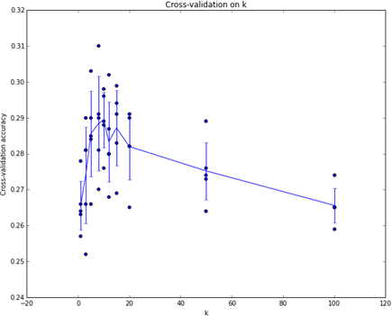
Setting Hyperparameters
Example of
5-fold cross-validation
for the value of k.
Each point: single
outcome.
The line goes
through the mean, bars indicated standard deviation
(Seems that k ~= 7 works best
for this data)
Lecture 2 -

Slide 31

What does this look like?
Lecture 2 -

Slide 32
What does this look like?
Lecture 2 -

Slide 33
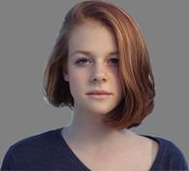
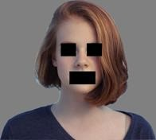
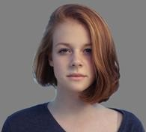

k-Nearest Neighbor with pixel distance never used.
- Distance metrics on pixels are not informative
Original image is CC0 public domain
Original Occluded Shifted (1 pixel)
Tinted
(All three images on the right have the same pixel distances to the one on the left)
Lecture 2 -

Slide 34
K-Nearest Neighbors: Summary
In image classification we start with a training set of images and labels, and must predict labels on the test set
The K-Nearest Neighbors classifier predicts labels based on the K nearest training examples
Distance metric and K are hyperparameters
Choose hyperparameters using the validation set Only run on the test set once at the very end!
Lecture 2 -

